Slide 1
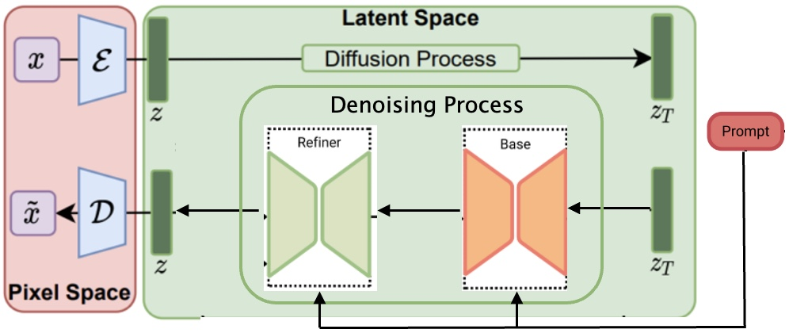
Samaritan SDXL
Upscaling
X
+
Y
Y
LoRA
Zero
conv
Trainable Copy
Zero
conv
+
ControlNet

Slide 2
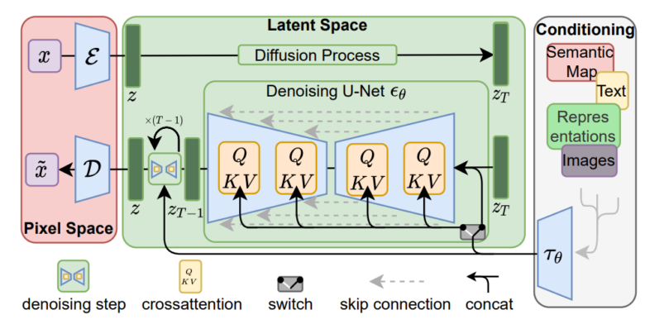
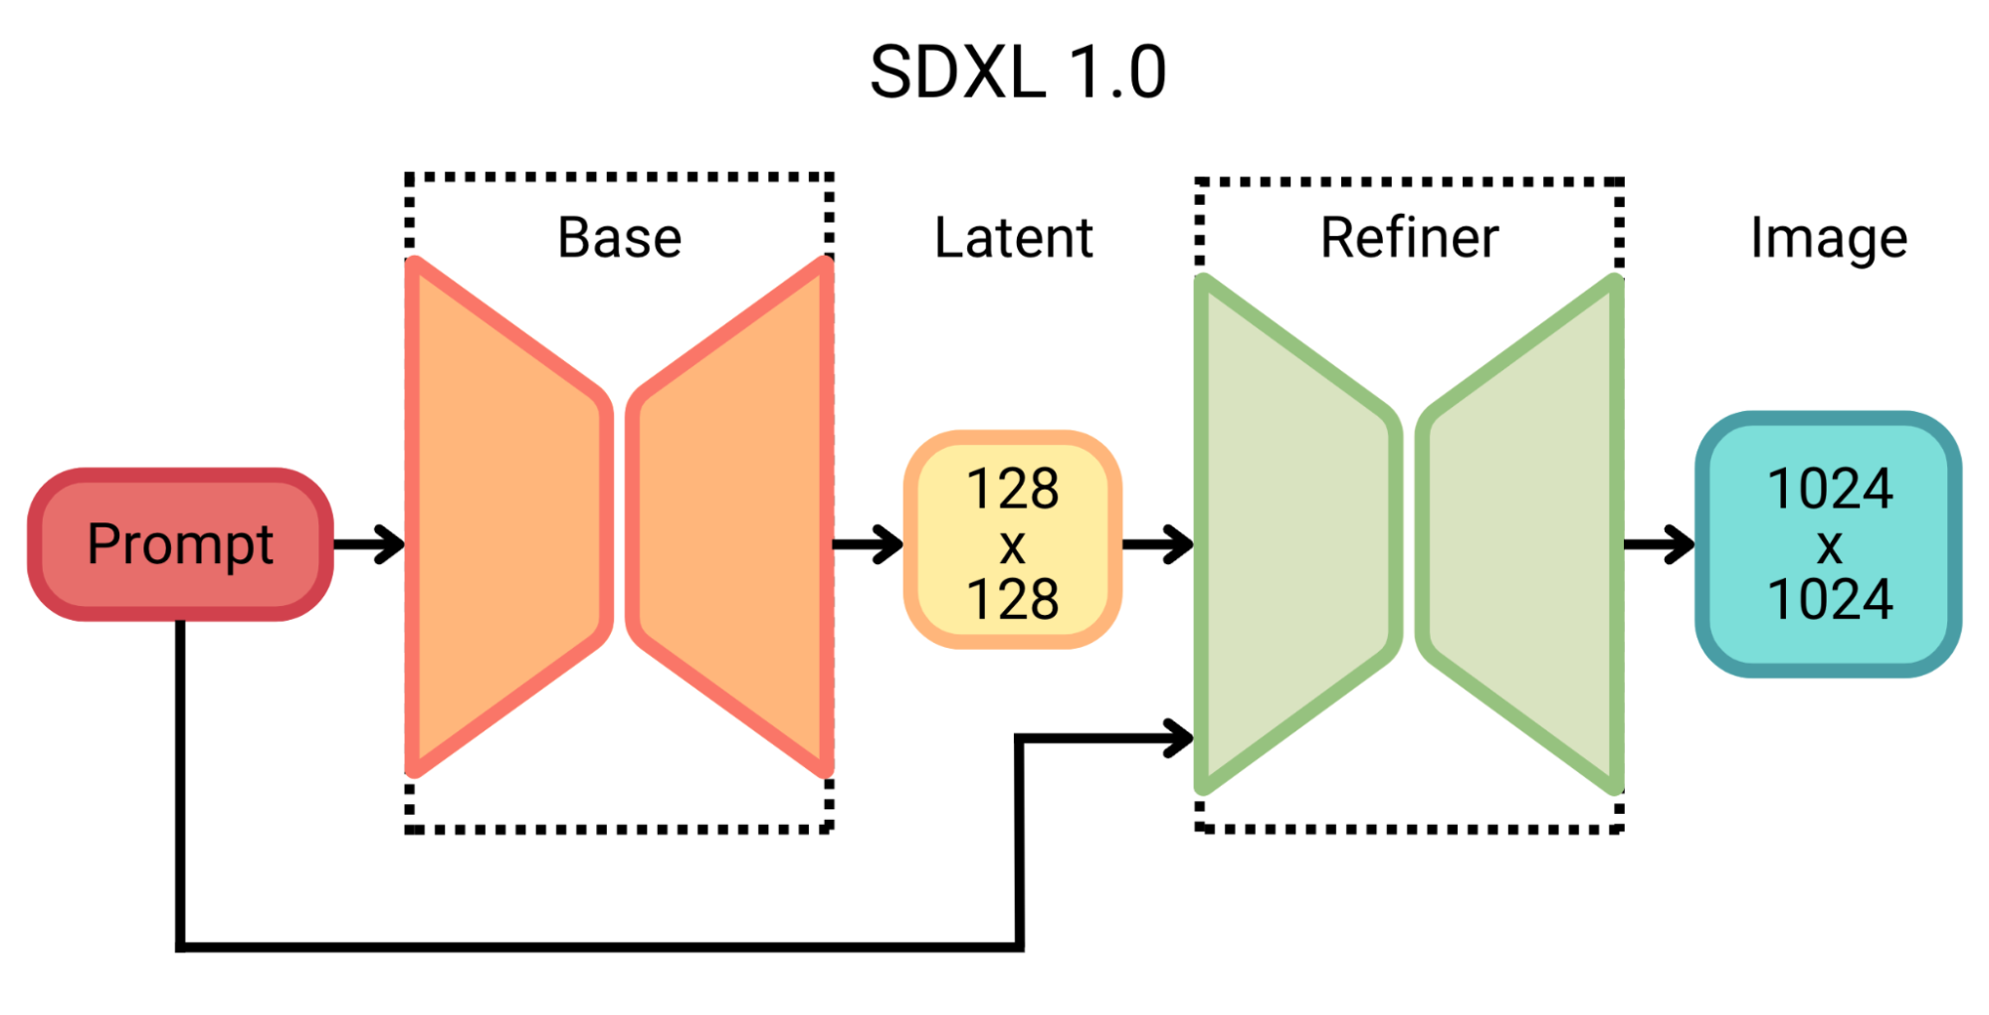
Denoising Process

